Slide 1
Chronic Complications of DM
Soghra Rabizadeh, MD
Associate professor of Endocrinology
Tehran University of Medical Sciences

Slide 2
Classification of Diabetes
Some forms of DM are characterized by:
An absolute insulin deficiency
2. Genetic defect leading to defective insulin secretion
3. Insulin resistance as their underlying etiology.

Slide 3
Classification
At present DM classification is on the basis of the pathogenic process that leads to hyperglycemia
As opposed to criteria such as:
Age of onset
Type of therapy

Slide 4
Classification
The two broad categories of DM are designated
Type 1 ( A or B)
Type 2
Type 1A DM results from
Autoimmune β cell destruction
Usually leads to insulin deficiency

Slide 5
The 3 main pathophysiological defects of Type 2 diabetes
β-cell dysfunction
Insulin-resistance
the “triumvirate”
Increased hepatic glucose production

Slide 6
Classification - Age
Age is no longer used as a criterion in the new classification system.
An autoimmune β cell destructive process can develop at any age.
Although type 1 DM most commonly develops < age of 30
It is estimated that 5 - 10% of individuals who develop DM > age 30 have type 1A DM.
Although type 2 DM more typically develops with increasing age, it occurs in children, particularly in obese adolescents.

Slide 7
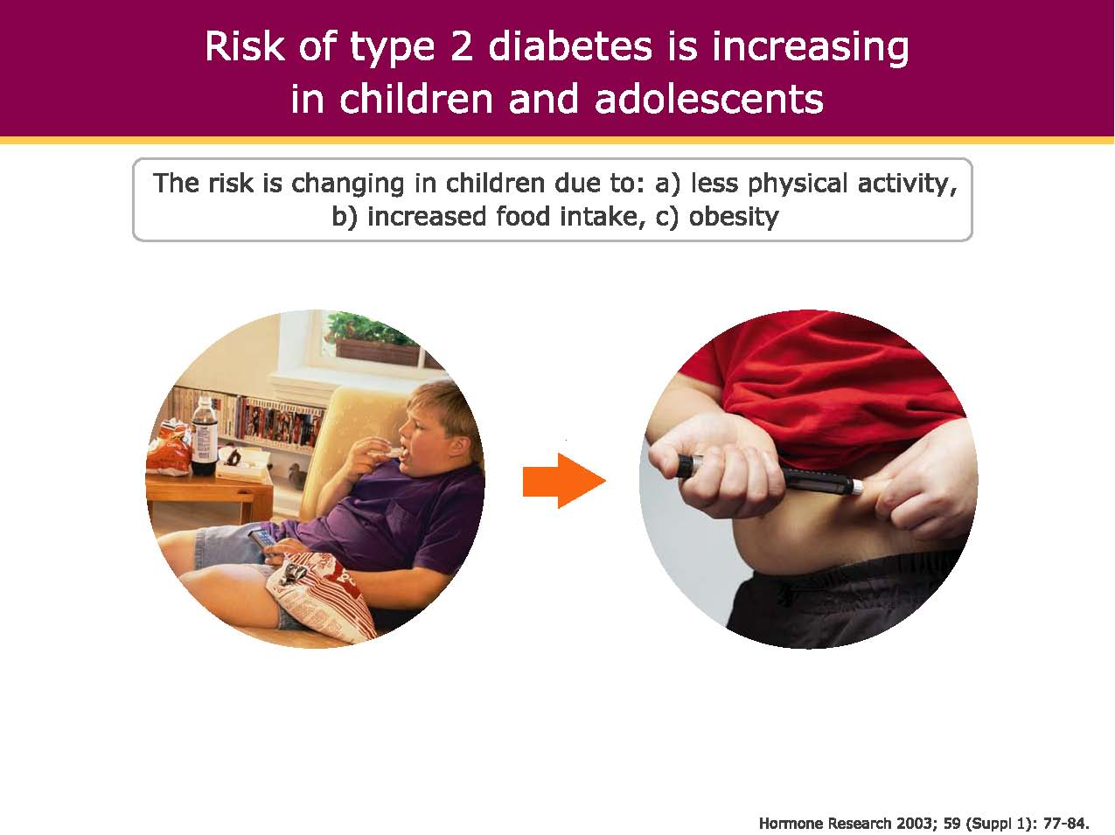
Risk of type 2 diabetes is increasing in children and adolescents

Slide 8
Differential Diagnosis
Type 1 and Type 2 Diabetes
Type 1 Diabetes Type 2 Diabetes
Usual clinical course Insulin-dependent Initially non-insulin-
dependent
Usual age of onset <20 years (but ~50% >40 years but
over 20 years) increasingly earlier
Body weight Usually lean Usually obese
Clinical onset Often acute Subtle, slow
Ketosis-prone Yes ketosis prone T2
Family history ≤15% with 1° relative Common
Frequency of HLA-DR3, Increased Not increased
DR4, DQB1*0201, *0302
Islet autoantibodies Present Absent-rare
(GADA, ICA, IA-2A, IAA)

Slide 9
Chronic Complications of DM

Slide 10
Chronic Complications of DM
Affect many organ systems
Responsible for majority of morbidity and mortality
Chronic complications can be divided into :
1) vascular
2) nonvascular
Vascular complications of DM subdivided into:
Microvascular (retinopathy, neuropathy, nephropathy)
Macrovascular complications CAD ,PAD, cerebrovascular disease.

Slide 11
Chronic Complications of DM
Nonvascular complications include:
Gastroparesis
Infections
Skin changes
Long-standing DM : hearing loss
Type 2 DM is associated with impaired mental function.

Slide 12
Vascular complication
Macrovascular
1-Coronary artery disease
2-Peripheral arterial disease
3-Cerebrovascular disease
Microvascular
1- Eye disease
Retinopathy(nonproliferative/proliferative)
Macular edema
2- Neuropathy
Sensory and motor(mono/ polyneuropathy)
Autonomic
3- Nephropathy

Slide 13
Other COMPLICATIONS
Gastrointestinal (gastroparesis, diarrhea)
Genitourinary (uropathy/sexual dysfunction)
Dermatologic
Infectious
Cataracts
Glaucoma
Periodontal disease

Slide 14
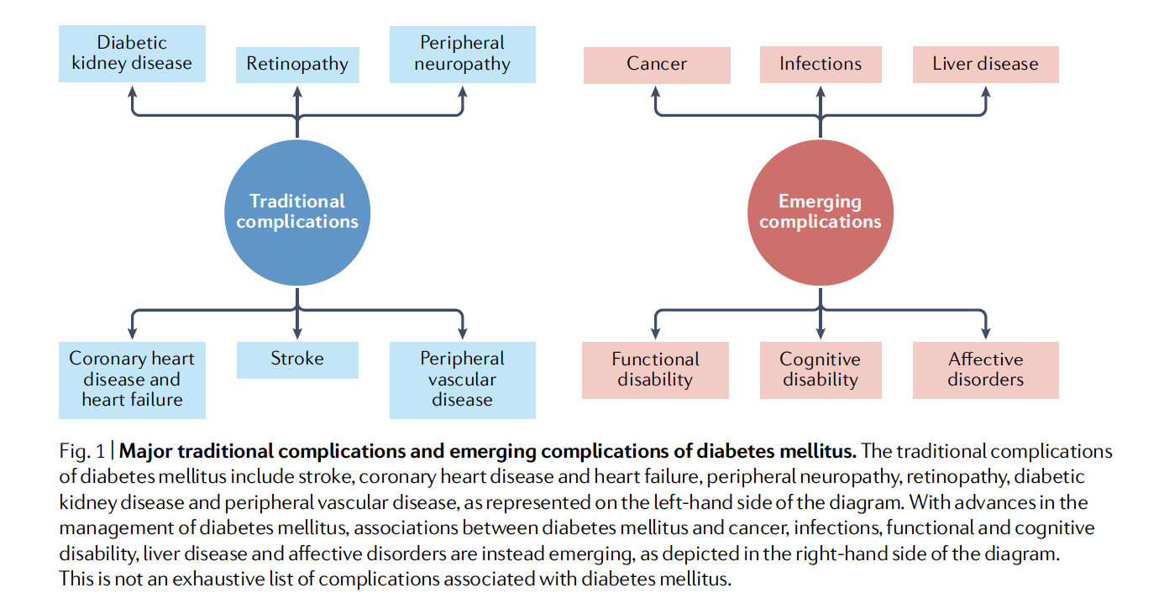
Traditional and emerging complications

Slide 15
Chronic Complications of DM
The risk of chronic complications increases as a function of:
Duration of hyperglycemia (usually in second decade of hyperglycemia).
Since type 2 DM often has a long asymptomatic hyperglycemia
Many individuals with type 2 DM have complications at the time of diagnosis.

Slide 16
Chronic Complications of DM
Microvascular complications of both type 1 and type 2 DM result from chronic hyperglycemia.
Large, RCT in type 1( DCCT) or type 2 DM (UKPDS) have demonstrated that a reduction in chronic hyperglycemia prevents or delays retinopathy, neuropathy, and nephropathy.

Slide 17
Chronic Complications of DM
Other incompletely defined factors may modulate the development of complications.
For example, despite long-standing DM, some individuals never develop nephropathy or retinopathy.
Suggesting that there is a genetic susceptibility for developing particular complications.

Slide 18
Duration of hyperglycemia
Degree of glycemic control
Chronic Complication
Genetic susceptibility
Major determinants of chronic complication

Slide 19
Macrovascular Complications of DM
Coronary heart disease events and mortality are two to four times greater in patients with type 2 DM.
These events correlate with fasting and postprandial glucose as well as with the A1C.
Other factors (dyslipidemia and hypertension) also play important roles in macrovascular complications.

Slide 20
Mechanisms of Complications
Although chronic hyperglycemia is an important etiologic factor leading to complications of DM
The mechanism(s) by which it leads to such diverse cellular and organ dysfunction is unknown.
Five prominent theories, have been proposed to explain how hyperglycemia might lead to the chronic complications of DM.

Slide 21
Mechanisms of Hyperglycemia Induced Tissue Damage
Formation of advanced glycation end products
Aldose reductase activity/redox changes
Diacylglycerol- protein kinase C activation
Hexosamine pathway
Oxidative stress pathway
Each of the five different pathogenic mechanisms reflects a single hyperglycemia-induced process: overproduction of superoxide by the mitochondrial electron transport chain

Slide 22
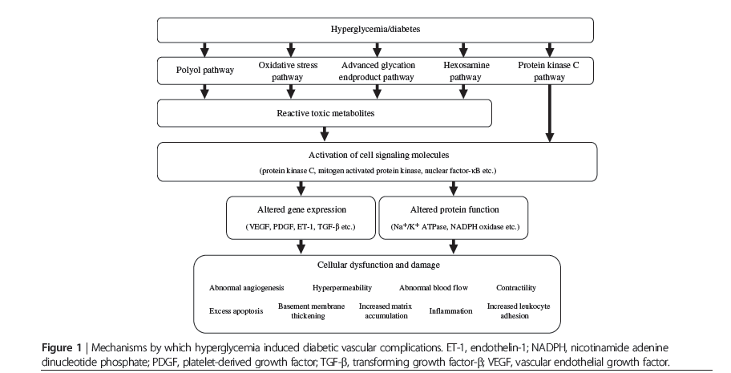

Slide 23
What Is Thought Linking These Mechanisms Causing Complications?
mitochondria
Euglycemia
ATP
Hyperglycemia
ROS (superoxide)
AGE pathway
Polyol pathway
Hexosamine pathway
Protein kinase C pathway

Slide 24
Superoxide and Oxidative Stress
Superoxide is the precursor of all ROS
That at elevated levels can cause oxidative stress

Slide 25
Unifying mechanism
A possible unifying mechanism is that hyperglycemia leads to increased production of reactive oxygen species or superoxide in the mitochondria

Slide 26
Glycemic Control and Complications
The goal of therapy is to achieve an A1C as close to normal as possible
Without subjecting the patient to excessive risk of hypoglycemia.

Slide 27
Ophthalmologic Complications
DM is the leading cause of blindness between the ages of 20 and 74 in the U S.
Individuals with DM are 25 times more likely to become legally blind than individuals without DM.

Slide 28
Ophthalmologic Complications

Slide 29
Ophthalmologic Complications
Blindness : progressive diabetic retinopathy and clinically significant macular edema.
Diabetic retinopathy is classified into two stages:
Non proliferative
Proliferative

Slide 30
proliferative
Neovascularization in response to retinal hypoxia : hallmark of proliferative diabetic retinopathy .
newly formed vessels appear near the optic nerve and/or macula and
rupture easily
leading to vitreous hemorrhage
fibrosis
ultimately retinal detachment.

Slide 31
Macular edema
Clinically significant macular edema can occur when only nonproliferative retinopathy is present.
Fluorescein angiography is useful to detect macular edema
Is associated with a 25% chance of moderate visual loss over the next 3 years.

Slide 32
Retinopathy
Best predictors of the development of retinopathy
Duration of DM
Degree of glycemic control
Hypertension is also a risk factor.

Slide 33
Retinopathy
Nonproliferative retinopathy is found in almost all individuals who have had DM for >20 years

Slide 34
Retinopathy
Although there is genetic susceptibility for retinopathy
It confers less influence than either the duration of DM or the degree of glycemic control.

Slide 35
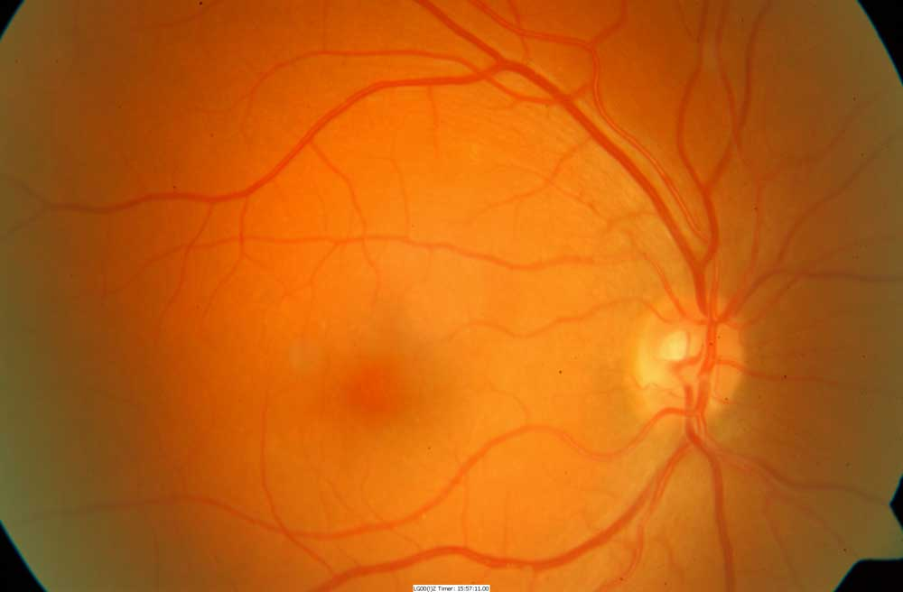
Normal retina

Slide 36
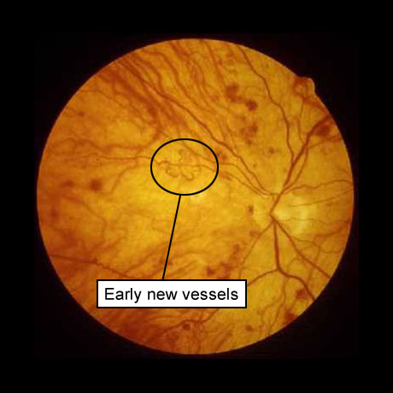
Early PDR

Slide 37
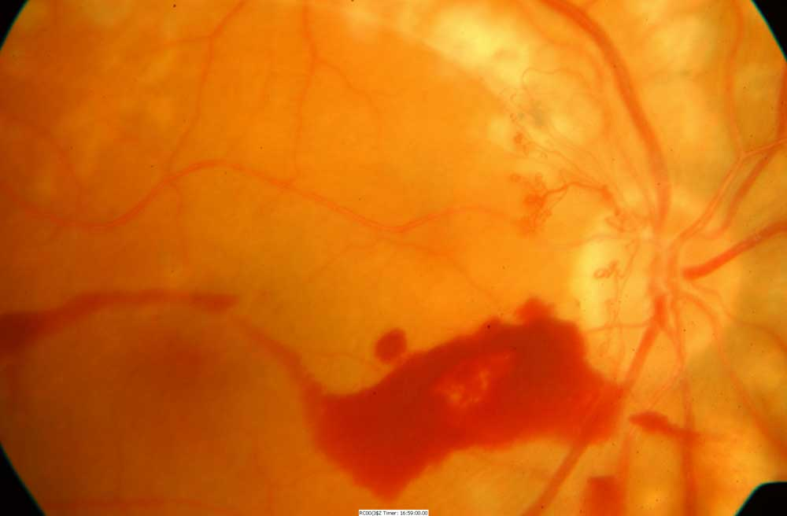
High risk PDR

Slide 38
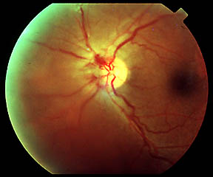
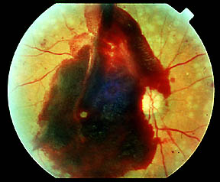
Proliferative Diabetic Retinopathy
New blood vessel growth
around optic nerve in
proliferative diabetic retinopathy
Hemorrhage from new
blood vessel growth in
proliferative diabetic retinopathy
http://www.neec.com/Vitreoretinal_Disease_Diabetic_Retinopathy.html

Slide 39
Renal Complications

Slide 40
Renal Complications
Diabetic nephropathy is the leading cause of ESRD in the US
A leading cause of DM-related morbidity and mortality.
Both microalbuminuria and macroalbuminuria in individuals with DM are associated with increased risk of cardiovascular disease.
Individuals with diabetic nephropathy commonly have diabetic retinopathy.

Slide 41
Diagnosis of Diabetic Kidney Disease
Diabetic kidney disease is usually a clinical diagnosis made based on the presence of albuminuria and/or reduced eGFR in the absence of signs or symptoms of other primary causes of kidney damage.
The typical presentation of diabetic kidney disease is considered to include :
Long-standing duration of diabetes ( may be first presentation )
Retinopathy
Albuminuria without hematuria
Gradually progressive kidney disease

Slide 42
Additional causes of kidney disease (non-DKD)
An active urinary sediment (containing RBC or WBC or cellular casts)
Rapidly increasing albuminuria or nephrotic syndrome
Rapidly decreasing eGFR
Absence of retinopathy (in type 1 diabetes)
may suggest alternative or additional causes of kidney disease

Slide 43
Renal Complications
Like other microvascular complications, the pathogenesis of diabetic nephropathy is related to chronic hyperglycemia.

Slide 44
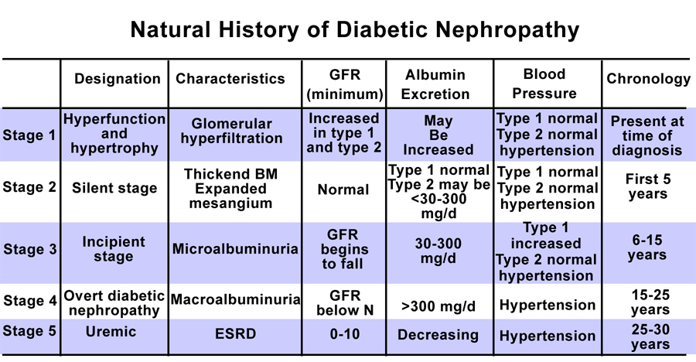

Slide 45
Renal Complications
Because only 20–40% of patients with diabetes develop diabetic nephropathy, additional susceptibility factors remain unidentified.
One known risk factor is a family history of diabetic nephropathy.

Slide 46
Renal Complications
After 5–10 years of type 1 DM, ~40% of individuals begin to excrete small amounts of albumin in urine.
Only ~50% of individuals progress to macroalbuminuria over the next 10 years.

Slide 47
Renal Complications
Once macroalbuminuria is present, there is a steady decline in GFR
~50% of individuals reach ESRD in 7–10 years
Once macroalbuminuria develops
BP rises slightly
Pathologic changes are likely irreversible.

Slide 48
GFR decline
Some individuals with type 1 or type 2 DM have a decline in GFR in the absence of micro- or macroalbuminuria
This is the basis for assessing the GFR on an annual basis using serum creatinine.

Slide 49
Nephropathy
Microalbuminuria or macroalbuminuria may be present when type 2 DM is diagnosed, reflecting its long asymptomatic period

Slide 50
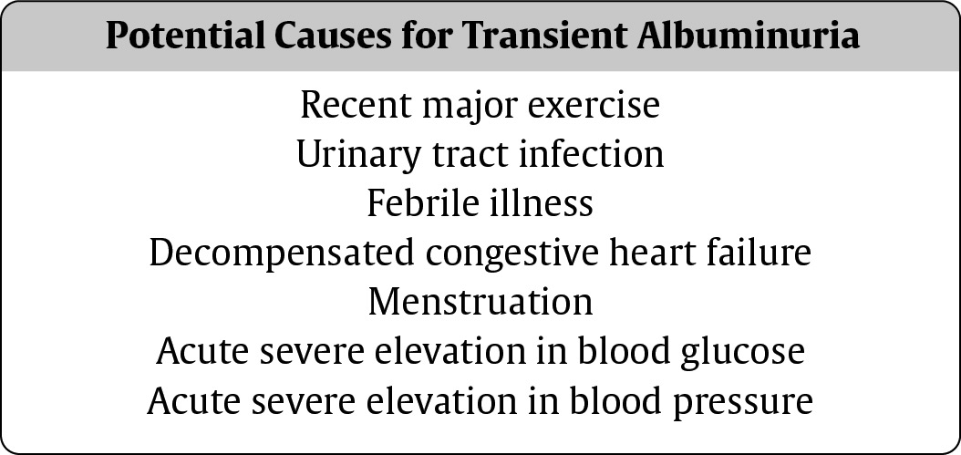
Beware of Transient Albuminuria

Slide 51
Renal Complications
Type IV renal tubular acidosis (hyporeninemic hypoaldosteronism) may occur in type 1 or 2 DM.
These individuals develop a propensity to hyperkalemia
May be exacerbated by medications [especially ACE inhibitors and angiotensin receptor blockers (ARBs)].

Slide 52
Radiocontrast Nephrotoxicity
Patients with DM are predisposed to radiocontrast-induced nephrotoxicity.
Risk factors for radiocontrast-induced nephrotoxicity are:
preexisting nephropathy
volume depletion.

Slide 53
Renal Complications
Individuals with DM undergoing radiographic procedures with contrast dye should be well hydrated before and after dye exposure
serum creatinine should be monitored for 24 h following the procedure.

Slide 54
Nephropathy: Treatment
The optimal therapy for diabetic nephropathy is prevention by control of glycemia.
As part of comprehensive diabetes care, microalbuminuria should be detected at an early stage when effective therapies can be instituted.
Annual measurement of serum creatinine to estimate GFR.

Slide 55
Treatment
Interventions effective in slowing progression from microalbuminuria to macroalbuminuria include:
(1) Normalization of glycemia
(2) Strict blood pressure control
(3) Administration of ACE inhibitors or ARBs.
Dyslipidemia should also be treated.

Slide 56
Neuropathy

Slide 57
Neuropathy
Diabetic neuropathy occurs in ~50% of individuals with long-standing type 1 and type 2 DM.
It may manifest as
Polyneuropathy
Mononeuropathy
Autonomic neuropathy.
As with other complications of DM, the development of neuropathy correlates with:
Duration of diabetes
Glycemic control
Additional risk factors are:
BMI (greater BMI, greater risk of neuropathy)
Smoking

Slide 58
Neuropathy
Both myelinated and unmyelinated nerve fibers are lost.

Slide 59
Neuropathy
Because the clinical features of diabetic neuropathy are similar to those of other neuropathies, the diagnosis of diabetic neuropathy should be made only after other possible etiologies are excluded

Slide 60
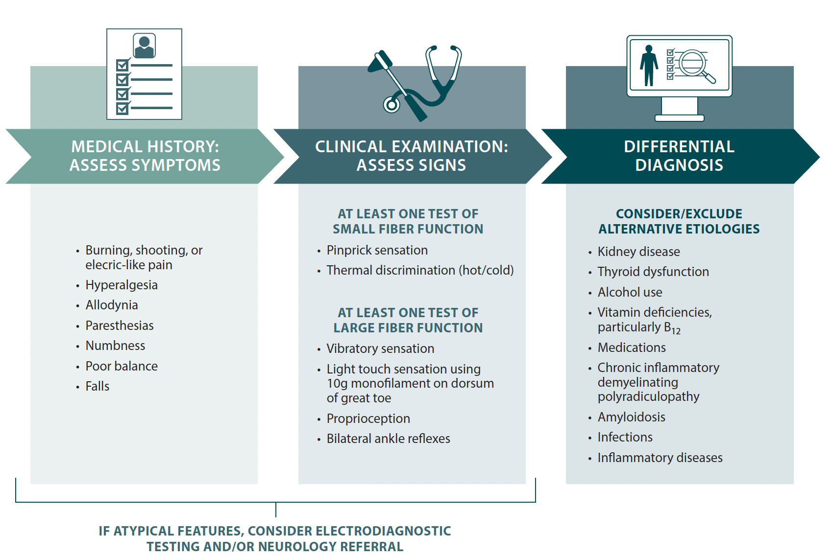
Approach to the diagnosis of diabetic peripheral neuropathy in the clinical setting.

Slide 61
Neuropathy screening
The ADA recommends screening for distal symmetric neuropathy beginning with the initial diagnosis of diabetes
Screening for autonomic neuropathy 5 years after diagnosis of type 1 DM and at the time of diagnosis of type 2 DM.
All individuals with diabetes should then be screened annually for both forms of neuropathy.

Slide 62
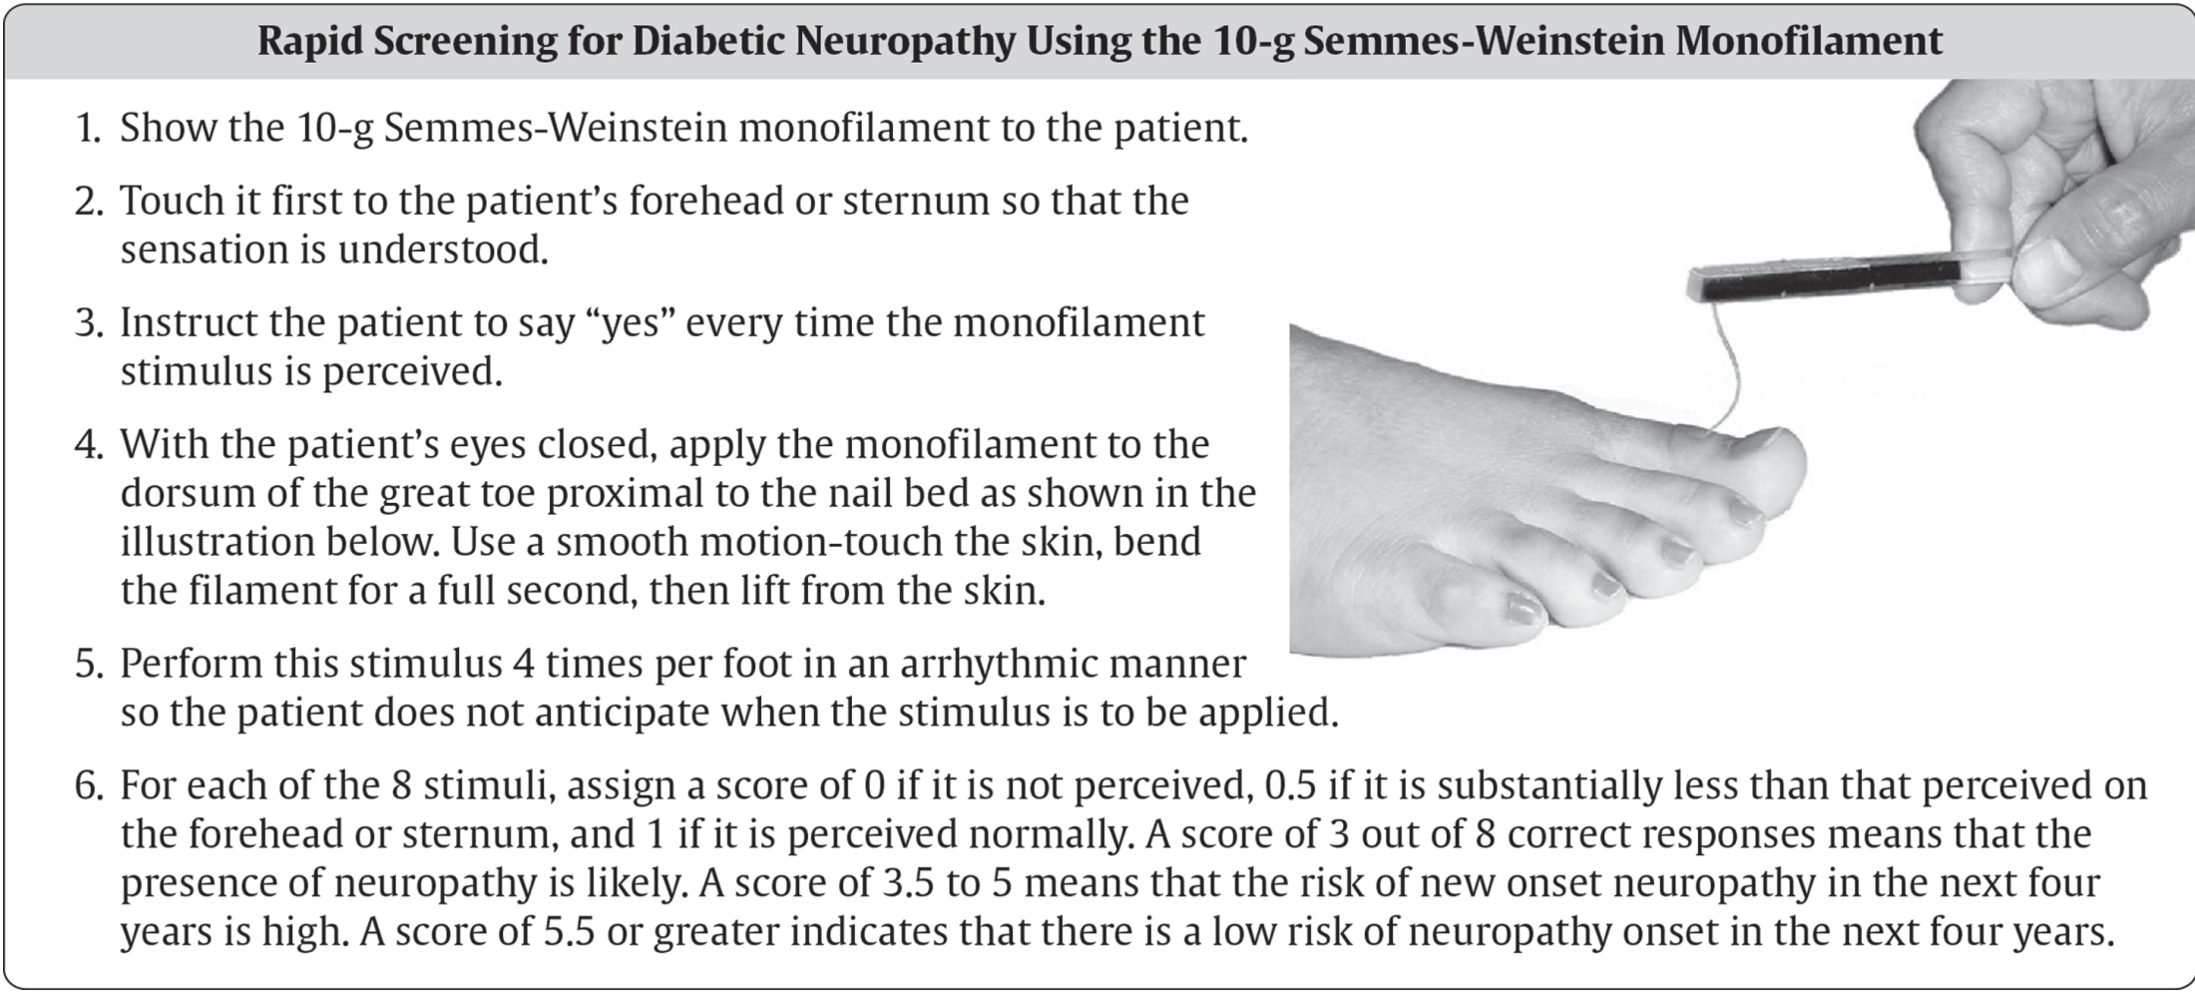
Screening
Refer to neurology if non-diabetic neuropathy is suspected

Slide 63
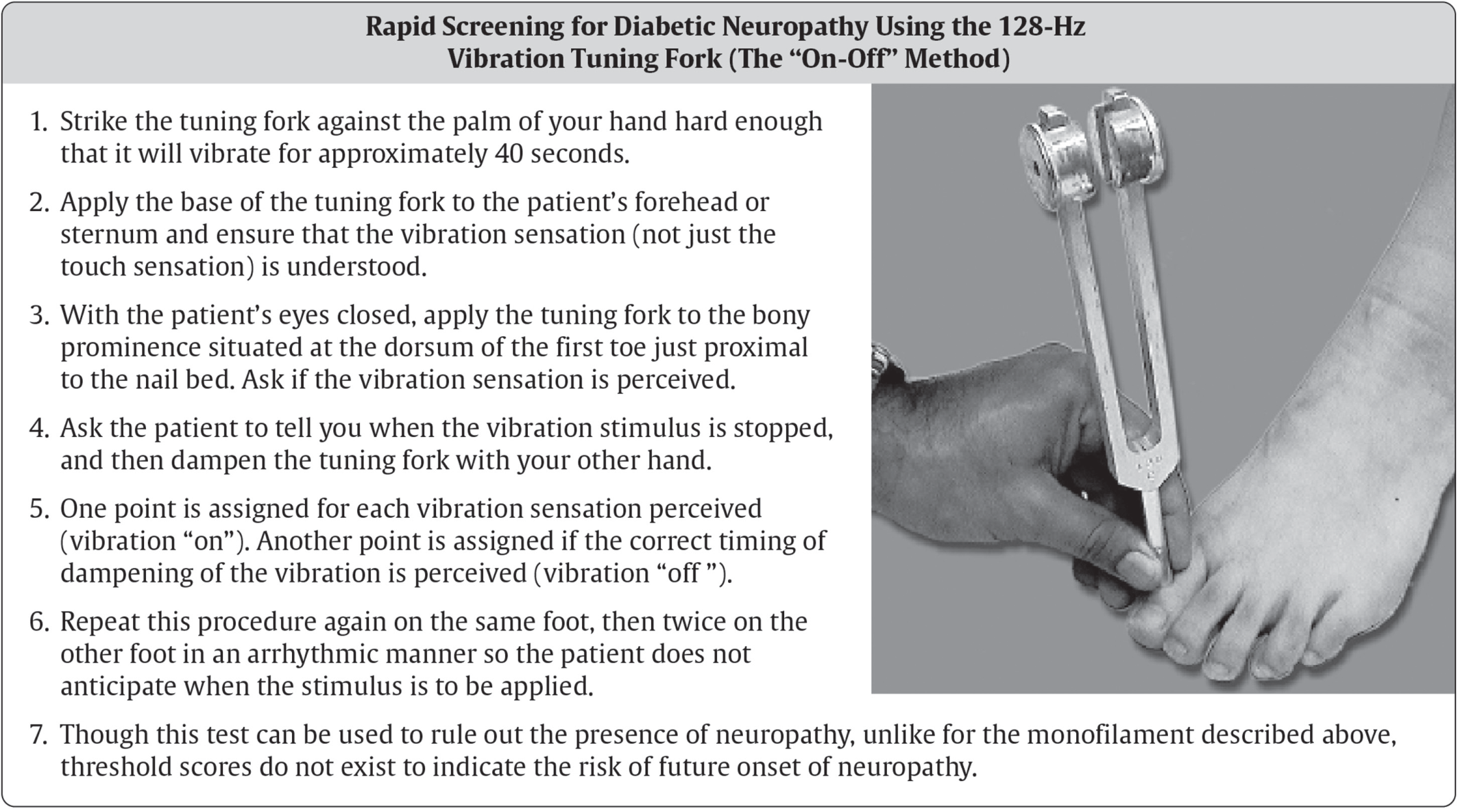
Screening
Refer to neurology if non-diabetic neuropathy is suspected

Slide 64
Monofilament test

Slide 65
1-Polyneuropathy
Most common form of diabetic neuropathy is distal symmetric polyneuropathy.
Most frequently presents with distal sensory loss
Up to 50% of patients do not have symptoms of neuropathy
Hyperesthesia, paresthesia, and dysesthesia also may occur.
Any combination of these symptoms may develop as neuropathy progresses.

Slide 66
Polyneuropathy
Symptoms may include a sensation of numbness, tingling, sharpness, or burning that begins in the feet and spreads proximally.
Neuropathic pain develops in some of these individuals, occasionally preceded by improvement in their glycemic control.

Slide 67
Polyneuropathy
Pain typically involves lower extremities, usually at rest, and worsens at night.
As diabetic neuropathy progresses, pain subsides and eventually disappears, but a sensory deficit in the lower extremities persists.

Slide 68
Polyneuropathy
Physical examination reveals :
Sensory loss
Loss of ankle reflexes
Abnormal position sense.

Slide 69
2-Diabetic polyradiculopathy
Characterized by severe pain in distribution of one or more nerve roots.
May be accompanied by motor weakness.
Intercostal or truncal radiculopathy causes pain over thorax or abdomen.
Involvement of lumbar plexus or femoral nerve cause severe pain in thigh or hip
May be associated with muscle weakness in hip flexors or extensors (diabetic amyotrophy)
Fortunately, diabetic polyradiculopathies are self-limited and resolve over 6–12 months.

Slide 70
3-Mononeuropathy
Dysfunction of isolated cranial or peripheral nerves is less common than polyneuropathy in DM
Presents with pain and motor weakness in the distribution of a single nerve
A vascular etiology has been suggested, but the pathogenesis is unknown.
Involvement of third cranial nerve is most common and is heralded by diplopia.

Slide 71
Mononeuropathy
Physical examination reveals
Ptosis
Ophthalmoplegia
Normal pupillary constriction to light.
Sometimes other cranial nerves IV, VI, or VII (Bell's palsy) are affected.

Slide 72
Autonomic Neuropathy
DM-related autonomic neuropathy can involve multiple systems, including:
Cardiovascular
Gastrointestinal
Genitourinary
Sudomotor
Metabolic systems.

Slide 73
Autonomic Neuropathy
Autonomic neuropathies affecting the cardiovascular system (CAN) cause:
Resting tachycardia
Orthostatic hypotension
Reports of sudden death have also been attributed to autonomic neuropathy.
Gastroparesis and bladder-emptying abnormalities are often caused by the autonomic neuropathy seen in DM.

Slide 74
Autonomic Neuropathy
Hyperhidrosis of the upper extremities
Anhidrosis of the lower extremities result from sympathetic nervous system dysfunction.
Anhidrosis of the feet can promote dry skin with cracking, which increases the risk of foot ulcers

Slide 75
Autonomic Neuropathy
Autonomic neuropathy
May reduce counterregulatory hormone release
Leading to an inability to sense hypoglycemia appropriately (hypoglycemia unawareness)
Subjecting the patient to the risk of severe hypoglycemia

Slide 76
Gl and GU Dysfunction
Long-standing type 1 and 2 DM may affect the motility and function of gastrointestinal (GI) and genitourinary systems.
The most prominent GI symptoms are :
Delayed gastric emptying (gastroparesis)
Altered small- and large-bowel motility (constipation or diarrhea).

Slide 77
Gl Dysfunction
Gastroparesis may present with :
Anorexia
Nausea
Vomiting
Early satiety
Abdominal bloating

Slide 78
Gl Dysfunction
Microvascular complications (retinopathy and neuropathy) are usually present.
Nuclear medicine scintigraphy after ingestion of a radiolabeled meal is the best study to document delayed gastric emptying, but may not correlate well with symptoms.

Slide 79
Gl Dysfunction
Parasympathetic dysfunction : is important in the development of gastroparesis
Hyperglycemia itself also impairs gastric emptying.
Nocturnal diarrhea, alternating with constipation, is a feature of DM-related GI autonomic neuropathy.

Slide 80
Gl Dysfunction
In type 1 DM, these symptoms should also prompt evaluation for celiac sprue because of its increased frequency.

Slide 81
GU Dysfunction
Diabetic autonomic neuropathy may lead to genitourinary dysfunction including :
Cystopathy
Male sexual (Erectile) dysfunction
Female sexual dysfunction:
Reduced sexual desire
Reduced vaginal lubrication
Dyspareunia

Slide 82
GU Dysfunction
Erectile dysfunction and retrograde ejaculation are very common in DM and may be one of the earliest signs of diabetic neuropathy.

Slide 83
Neuropathy
All people with diabetes should be assessed for diabetic peripheral neuropathy starting at diagnosis of type 2 diabetes and 5 years after the diagnosis of type 1 diabetes and at least annually thereafter. B

Slide 84
Neuropathy
12.18 Assessment for distal symmetric polyneuropathy should include a careful history and assessment of either temperature or pinprick sensation (small-fiber function) and vibration sensation using a 128-Hz tuning fork (for large-fiber function).
All people with diabetes should have annual 10-g monofilament testing to identify feet at risk for ulceration and amputation. B

Slide 85
Neuropathy
12. Retinopathy, Neuropathy, and Foot Care
12.19 Symptoms and signs of autonomic neuropathy should be assessed in people with diabetes starting at diagnosis of type 2 diabetes and 5 years after the diagnosis of type 1 diabetes, and at least annually thereafter, and with evidence of other microvascular complications, particularly kidney disease and diabetic peripheral neuropathy.
Screening can include asking about orthostatic dizziness, syncope, early satiety, erectile dysfunction, changes in sweating patterns, or dry cracked skin in the extremities.

Slide 86
Neuropathy – Treatment
12. Retinopathy, Neuropathy, and Foot Care
12.20 Optimize glucose management to prevent or delay the development of neuropathy in people with type 1 diabetes A and to slow the progression of neuropathy in people with type 2 diabetes. C
Optimize weight, blood pressure, and serum lipid management to reduce the risk or slow the progression of diabetic neuropathy. B

Slide 87
Neuropathy – Treatment
12. Retinopathy, Neuropathy, and Foot Care
12.21 Assess and treat pain related to diabetic peripheral neuropathy B and symptoms of autonomic neuropathy to improve quality of life. E
12.22 Gabapentinoids, serotoninnorepinephrine reuptake inhibitors, tricyclic antidepressants, and sodium channel blockers are recommended as initial pharmacologic treatments for neuropathic pain in diabetes. A
Opioids, including tramadol and tapentadol, should not be used for neuropathic pain treatment in diabetes given the potential for adverse events. B

Slide 88
Foot Care (continued)
12. Retinopathy, Neuropathy, and Foot Care
12.27 Initial screening for peripheral arterial disease (PAD) should include assessment of lower-extremity pulses, capillary refill time, rubor on dependency, pallor on elevation
Individuals with a history of leg fatigue, claudication, and rest pain relieved with dependency or decreased or absent pedal pulses should be referred for ankle-brachial index with toe pressures and for further vascular assessment as appropriate. B

Slide 89
Foot Care (continued)
12. Retinopathy, Neuropathy, and Foot Care
12.30 Provide general preventive foot self-care education to all people with diabetes, including those with loss of protective sensation, on appropriate ways to examine their feet (palpation or visual inspection with an unbreakable mirror) for daily surveillance of early foot problems. B

Slide 90
Foot Care (continued)
12. Retinopathy, Neuropathy, and Foot Care
12.31 The use of specialized therapeutic footwear is recommended for people with diabetes at high risk for ulceration, including those with loss of protective sensation, foot deformities, ulcers, callous formation, poor peripheral circulation, or history of amputation. B

Slide 91
Factors that are associated with the at-risk foot include the following:
Poor glycemic management
Peripheral neuropathy/LOPS
PAD
Foot deformities (bunions, hammertoes, Charcot joint, etc.)
Preulcerative corns or calluses
Prior ulceration
Prior amputation
Smoking
Retinopathy
Nephropathy (particularly individuals on dialysis or posttransplant)

Slide 92
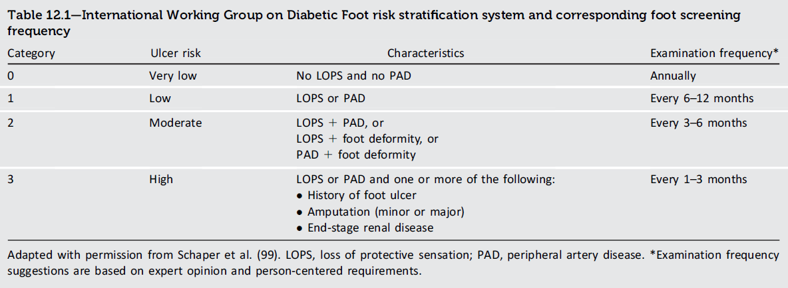
12. Retinopathy, Neuropathy, and Foot Care
Retinopathy, Neuropathy, and Foot Care:
Standards of Care in Diabetes - 2025 Diabetes Care 2025;48(Suppl. 1):S252-S265

Slide 93
Lower Extremity Complications
The peripheral sensory neuropathy interferes with normal protective mechanisms
Allows the patient to sustain major or repeated minor trauma to the foot, often without knowledge of the injury.

Slide 94
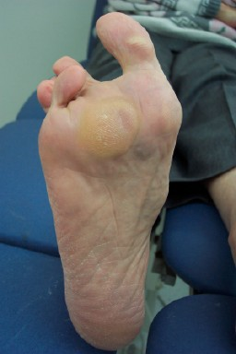
Diabetic Neuropathy
Patients with neuropathy lose their sensation of pain.
As a result, they exert a lot of pressure at one spot under the foot when they walk, building up a callus at that site without causing discomfort.
The pressure becomes so high that eventually it causes breakdown of tissues and ulceration.

Slide 95
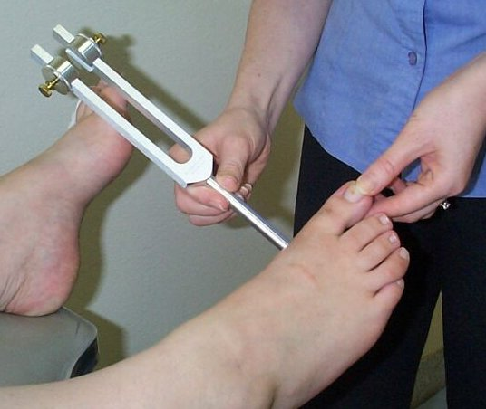
Test for vibration loss
a 128-Hz tuning fork

Slide 96

Touch-pressure sensation
10 g Monofilament

Slide 97
Cardiovascular disease

Slide 98


Diabetes greatly increases the risk of CV disease
2×
Patients with T2D have twice the risk
of CV disease compared with the
general population

Slide 99


A large proportion of patients with T2D have CV disease
Globally, approximately 1/3 of patients
with T2D have CV disease

Slide 100
Cardiovascular Morbidity and Mortality
Type 2 diabetes patients without a prior MI have a similar risk for coronary artery events as nondiabetic individuals who have had a prior MI.

Slide 101
Cardiac stress test indications
Because of extremely high prevalence of CVD especially type 2 DM cardiac stress test should be sought in an individual with:
1- Diabetes who has symptoms suggestive of cardiac ischemia
2- PAD
3- Carotid arterial disease
4- Resting ECG indicative of prior infarction
5- Plans to initiate an exercise program
6- Proteinuria
7- Two other cardiac risk factors.

Slide 102
Cardiovascular Disease—Screening (continued)
Cardiovascular Disease and Risk Management
In asymptomatic individuals with diabetes and abnormal natriuretic peptide levels, echocardiography is recommended to identify stage B heart failure.
In asymptomatic individuals with diabetes and age ≥ 50 years, microvascular disease in any location, or foot complications or any end-organ damage from diabetes, screening for PAD with ankle-brachial index testing is recommended to guide treatment for cardiovascular disease prevention and limb preservation.
In individuals with diabetes duration ≥10 years, screening for PAD should be considered.

Slide 103
Cardiovascular Morbidity and Mortality
Whether and how to screen asymptomatic individuals with diabetes for CAD is controversial.
The absence of chest pain ("silent ischemia") is common in individuals with diabetes
A thorough cardiac evaluation is indicated in individuals undergoing major surgical procedures

Slide 104
Cardiovascular Morbidity and Mortality
Insulin resistance, as reflected by elevated serum insulin
is associated with an increased risk of cardiovascular complications in individuals with and without DM.

Slide 105
Cardiovascular Morbidity and Mortality
In addition to CAD, cerebrovascular disease is increased in individuals with DM (threefold increase in stroke).
Individuals with DM have an increased incidence of CHF.

Slide 106
Cardiovascular Risk Factors
Dyslipidemia
Individuals with DM may have several forms of dyslipidemia
Because of the additive cardiovascular risk of hyperglycemia and hyperlipidemia
lipid abnormalities should be assessed aggressively and treated as part of comprehensive diabetes care

Slide 107
Dyslipidemia
The most common pattern of dyslipidemia is:
Hypertriglyceridemia
Reduced HDL c
DM itself does not increase levels of LDL
But small dense LDL particles found in type 2 DM are more atherogenic because they are more easily glycated and susceptible to oxidation.

Slide 108
Dyslipidemia
Large prospective trials of primary and secondary intervention for CHD have included some individuals with type 2 DM, and subset analyses have consistently found that reductions in LDL reduce cardiovascular events and morbidity in individuals with DM.

Slide 110
High and moderate intensity statin

Slide 111
Thanks for your attention

Slide 112
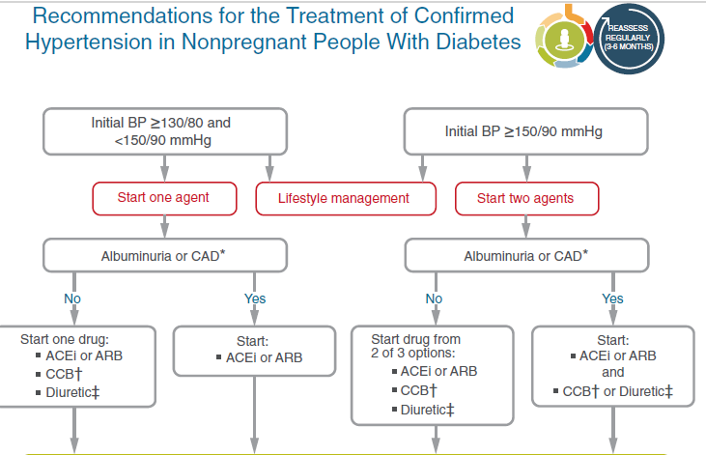
Cardiovascular Disease and Risk Management
Recommendations for the Treatment of Confirmed Hypertension in People with Diabetes (1 of 2)
Cardiovascular Disease and Risk Management:
Standards of Care in Diabetes - 2024. Diabetes Care 2024;47(Suppl. 1):S179-S218

