Slide 1
Standards of Care in Diabetes—2025
M. Nakhjavani,MD
January 12, 2025

Slide 2
ASSESSMENT OF COMORBIDITIES
Autoimmune Diseases
Bone Health
Cancer
Cognitive Impairment/Dementia
Dental care
Disability
Hepatitis C
Low Testosterone in Men and Erectile Dysfunction
Female Sexual Dysfunction
Metabolic Dysfunction–Associated Steatotic Liver Disease and Metabolic Dysfunction–Associated Steatohepatitis

Slide 3
DIABETES: First Description
“Diabetes [Mellitus] is a remarkable disorder, and not one very common to man… The disease is chronic in its character, and is slowly engendered, though the patient does not survive long when it is completely established, for the marasmus produced is rapid, and death speedy. Life too is odious and painful, the thirst is ungovernable, and the copious potations are more than equaled by the profuse urinary discharge; for more urine flows away, and it is impossible to put any restraint to the patient’s drinking or making water. For if he stops for a very brief period, and leaves off drinking, the mouth becomes parched, the body dry; the bowels seem on fire, he is wretched and uneasy, and soon dies, tormented with burning thirst.”
ARETAEUS OF CAPPODOCIA (ca. 120 A.D. - 200 A.D.)

Slide 4
DIABETES: First Description
دیابت شیرین بیماری قابل توجهی است و برای انسان چندان شایع نیست. این بیماری مزمن است و به آرامی ایجاد می شود، اگرچه بیمار پس از ایجاد کامل آن مدت زیادی زنده نمی ماند، زیرا ماراسموس تولید شده سریع است . مرگ سریع، زندگی نیز دردناک است، تشنگی غیرقابل کنترل است، و نوشیدنی های فراوان با ترشحات فراوان ادرار برابر است. زیرا ادرار بیشتری دفع می‌شود و نمی‌توان هیچ گونه محدودیتی برای نوشیدن آب بیمار ایجاد کرد. زیرا اگر برای مدت کوتاهی توقف کند و نوشیدن را ترک کند، دهانش خشک می شود و بدنش خشک می شود. به نظر می‌رسد که روده‌ها در آتش می‌سوزند، او بدبخت و مضطرب است، و به زودی در عذاب تشنگی می‌میرد.»
ARETAEUS OF CAPPODOCIA (ca. 120 A.D. - 200 A.D.)

Slide 5
Good Diabetes Management
HbA1c close to normal
No (severe) hypoglycemia
Low glucose variability
Optimal Time in Range
Low risk for micro- and macrovascular complications
Patient capable of self-managing diabetes
Quality of Life close to ‘normal’
Physical, Mental and Social wellbeing
Satisfied with care

Slide 6
Where are we?
30% elevated HbA1c
Glucose variability a problem for many
Severe hypoglycemia affecting 25% T1 diabetes
30-40% develop serious diabetes complications
Reduced life expectancy
30% have adjustment problems (distress)
Mental quality of life lower than healthy controls
Limited social/role functioning in many settings
Patients’ unmet needs

Slide 7
Glycemic Control for Type 2 Diabetes Mellitus Patients: A Systematic Review
The prevalence of poor glycemic control was high, and it ranged between 45.2% and 93% among the studies.
The factors associated with glycemic control were stratified into four categories:
Personal: Education level, gender, body mass index, and obesity.
Clinical: Duration of T2DM, fasting glucose level, and hypertension
Medication-related: Number of anti-diabetics and regimen of diabetes treatment
Behavioral factors: Adherence to treatment and exercise
DOI: 10.7759/cureus.26180
Published 06/21/2022

Slide 8
Case 1
ID/CC: 56 years old man with T2DM _ 6 years on Metformin.
A1c increasing to 7.8% over the past year.
Further attempts at lifestyle change unsuccessful.
PMH: HTN on losartan, receives rosuvastatin.
Father had CAD
Highly compliant/adherent.
Declines injectables.

Slide 9
Case 1
PE: Obese, BMI= 31.5,
BP= 142/84,
Data: A1c 7.8%, FPG 147,
Cr =1.1 (eGFR =60),
LDL 84, HDL 38, TG 256,
ECG: normal.
Your recommendation?

Slide 10
Section 4.
Comprehensive Medical Evaluation and Assessment of Comorbidities

Slide 11
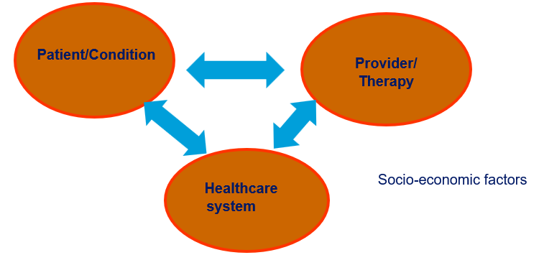

Slide 12
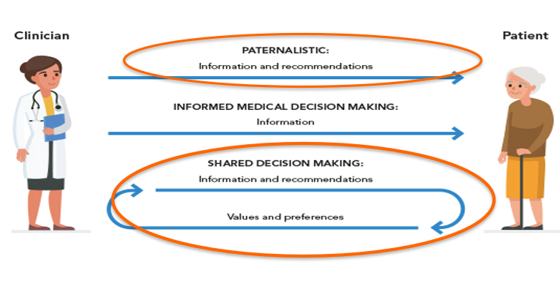
Patient Physician Co-operation

Slide 13
Comprehensive Medical Evaluation
Comprehensive Medical Evaluation and Assessment of Comorbidities
4.3 A complete medical evaluation should be performed at the initial visit to:
  Confirm the diagnosis and classify diabetes. A

Slide 14
Classification
Classification and Diagnosis of Diabetes
Diabetes can be classified into the following general categories:
Type 1 diabetes (due to autoimmune ß-cell destruction, usually leading to absolute insulin deficiency, including latent autoimmune diabetes of adulthood)
Type 2 diabetes (due to a non-autoimmune progressive loss of adequate ß-cell insulin secretion frequently on the background of insulin resistance and metabolic syndrome)
Specific types of diabetes due to other causes, e.g., monogenic diabetes syndromes (such as neonatal diabetes and maturity-onset diabetes of the young), diseases of the exocrine pancreas (such as cystic fibrosis and pancreatitis), and drug- or chemical-induced diabetes (such as with glucocorticoid use, in the treatment of HIV/AIDS, or after organ transplantation)
Gestational diabetes mellitus (diabetes diagnosed in the second or third trimester of pregnancy that was not clearly overt diabetes prior to gestation)

Slide 15
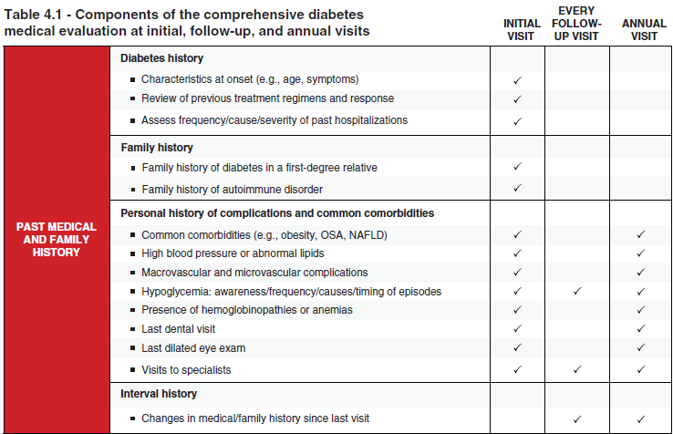
Comprehensive Medical Evaluation and Assessment of Comorbidities
Diabetes Care 2024;47(Suppl. 1):S52–S76 | https://doi.org/10.2337/dc24-S004

Slide 16
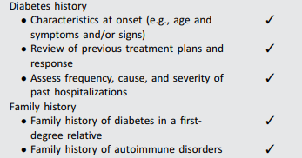
Components of the comprehensive diabetes medical evaluation at initial, follow-up, and annual visits
Visit
Initial | Every follow-up | Annual

Slide 17
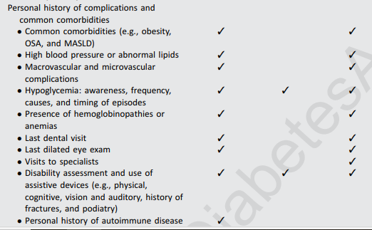
Components of the comprehensive diabetes medical evaluation at initial, follow-up, and annual visits
Visit
Initial | Every follow-up | Annual

Slide 18
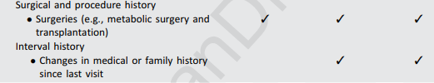
Components of the comprehensive diabetes medical evaluation at initial, follow-up, and annual visits
Visit
Initial | Every follow-up | Annual

Slide 19
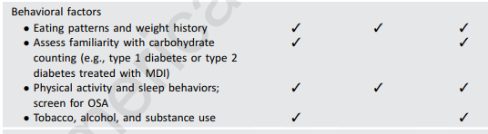
Components of the comprehensive diabetes medical evaluation at initial, follow-up, and annual visits
Visit
Initial | Every follow-up | Annual

Slide 20
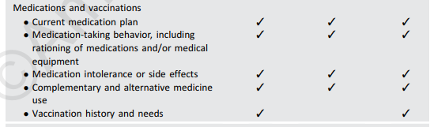
Components of the comprehensive diabetes medical evaluation at initial, follow-up, and annual visits
Visit
Initial | Every follow-up | Annual

Slide 21

Components of the comprehensive diabetes medical evaluation at initial, follow-up, and annual visits
Visit
Initial | Every follow-up | Annual

Slide 22
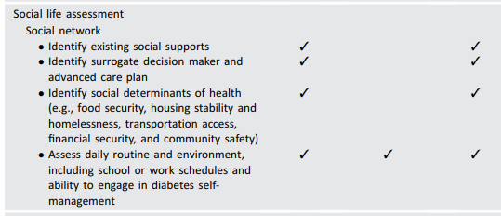
Components of the comprehensive diabetes medical evaluation at initial, follow-up, and annual visits
Visit
Initial | Every follow-up | Annual

Slide 23
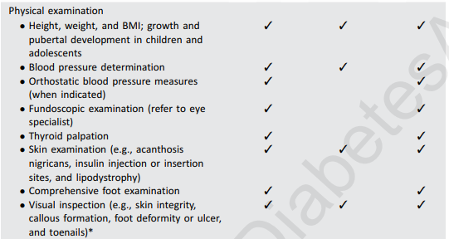
Components of the comprehensive diabetes medical evaluation at initial, follow-up, and annual visits
Visit
Initial | Every follow-up | Annual

Slide 24
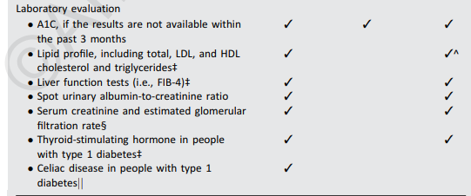
Components of the comprehensive diabetes medical evaluation at initial, follow-up, and annual visits
Visit
Initial | Every follow-up | Annual

Slide 25
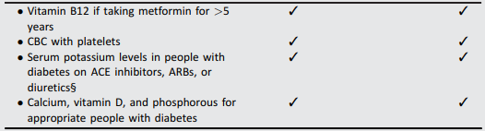
Components of the comprehensive diabetes medical evaluation at initial, follow-up, and annual visits
Visit
Initial | Every follow-up | Annual

Slide 26
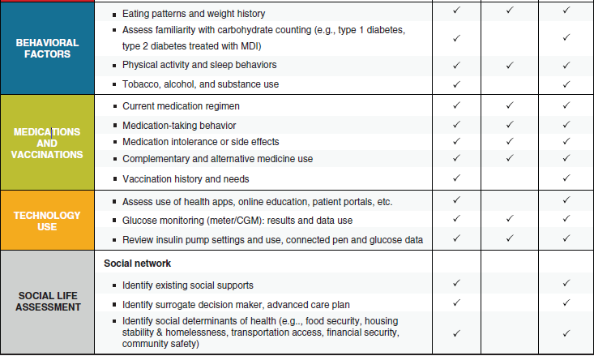
Comprehensive Medical Evaluation and Assessment of Comorbidities
Diabetes Care 2024;47(Suppl. 1):S52–S76 | https://doi.org/10.2337/dc24-S004

Slide 27
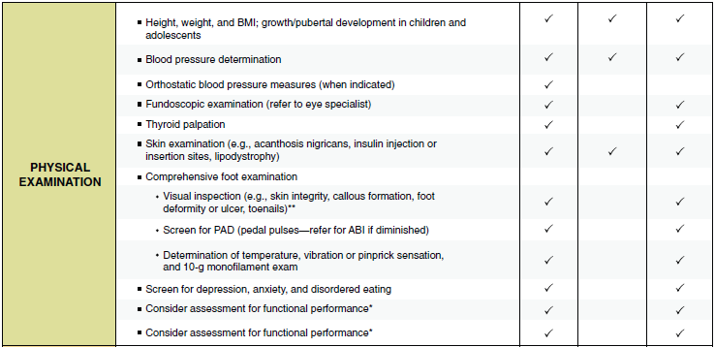
Comprehensive Medical Evaluation and Assessment of Comorbidities
Diabetes Care 2024;47(Suppl. 1):S52–S76 | https://doi.org/10.2337/dc24-S004

Slide 28
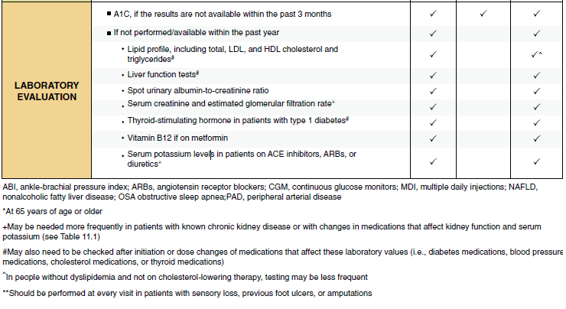
Comprehensive Medical Evaluation and Assessment of Comorbidities
Comprehensive Medical Evaluation and Assessment of Comorbidities:
Standards of Care in Diabetes - 2023. Diabetes Care 2023;46(Suppl. 1):S49-S67

Slide 29
Assessment, planning, and referral
Assessing risk of diabetes complications
1-ASCVD and heart failure history
2-ASCVD risk factors and 10-year ASCVD risk assessment
3-Staging of chronic kidney disease
4-Hypoglycemia risk
5-Assessment for retinopathy
6-Assessment for neuropathy
7-assessment for MASLD and MASH

Slide 30
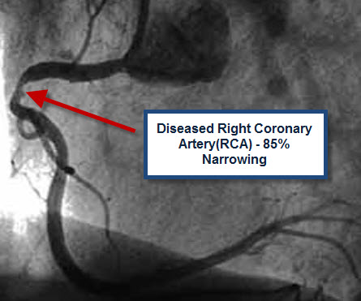


Slide 31
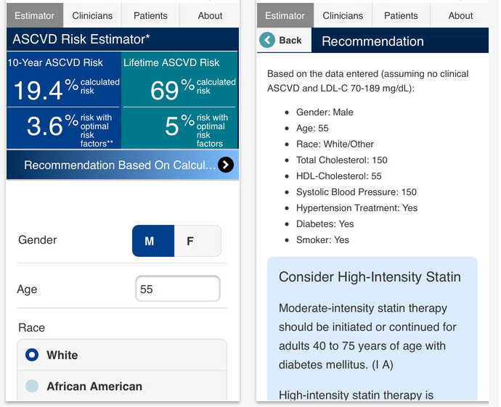
ASCVD Risk Estimator

Slide 32

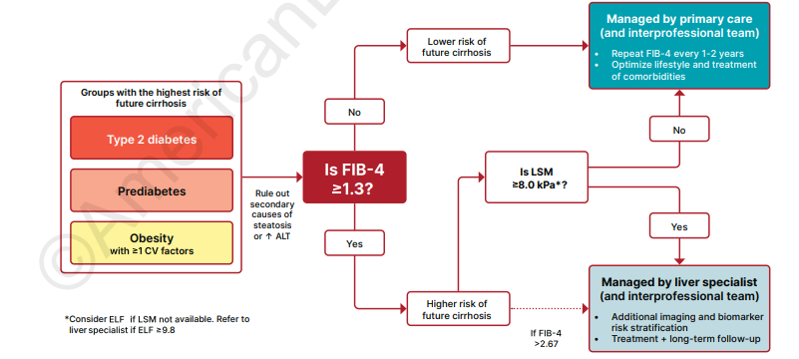

Slide 33
Assessment, planning, and referral
Goal setting
1-Set A1c/blood glucose/time in range target
Set lipid goal
2-If hypertension is present, establish blood pressure target
Weight management and physical activity goals
3- Diabetes elf-management goals

Slide 34
Assessment, planning, and referral
Therapeutic treatment plans
Lifestyle management
Pharmacologic therapy: glucose lowering
Pharmacologic therapy: cardiovascular and renal disease risk factors
Weight management with pharmacotherapy or metabolic surgery, as appropriate
Use of glucose monitoring and insulin delivery devices
Referral to diabetes education and medical specialists

Slide 35
Assessment, planning, and referral
Referrals for initial care management
Eye care for annual dilated eye exam
Family planning
Medical nutrition therapy consult
Diabetes self management education and support
Dental and periodontal examination
Behavioral health professional, if indicated
Audiology
Social worker
Rehabilitation medicine for physical and cognitive disability

Slide 36
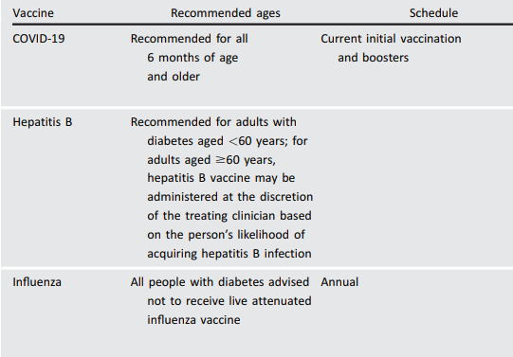
Highly recommended immunizations for adults with diabetes

Slide 37
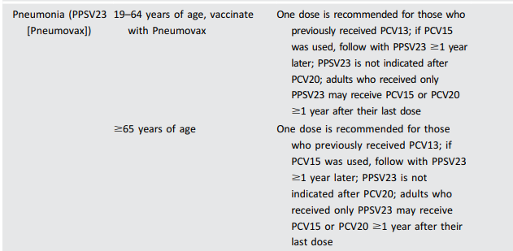
Highly recommended immunizations for adults with diabetes

Slide 38
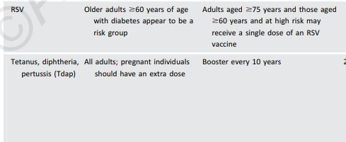

Highly recommended immunizations for adults with diabetes

Slide 39
.
Glycemic Targets

Slide 40
Case 2
ID/CC: 56 years old man with recent diagnosis of T2DM _ Unable to tolerate Metformin.
A1c 8.5 and 9% on two occasions.
Further attempts at lifestyle change unsuccessful.
PMH: HTN on valsartan.
Highly compliant/adherent.
Declines injectables.

Slide 41
Case 2
PE: Obese, BMI= 31, BP= 135/85,
Data: A1c 9%, FPG 157,
Cr 1.1 (eGFR =60),
LDL 94, HDL 38, TG 240,
ECG: normal.
Your recommendation?

Slide 42
Glycemic Assessment
Glycemic targets
Assess glycemic status (A1C or other glycemic measurement such as time in range or glucose management indicator) at least two times a year in patients who are meeting treatment goals (and who have stable glycemic control).
Assess glycemic status at least quarterly and as needed in patients whose therapy has recently changed and/or who are not meeting glycemic goals.

Slide 43
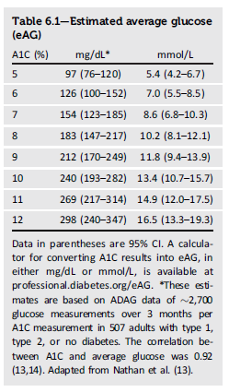
Estimated Average Glucose
Glycemic targets

Slide 44
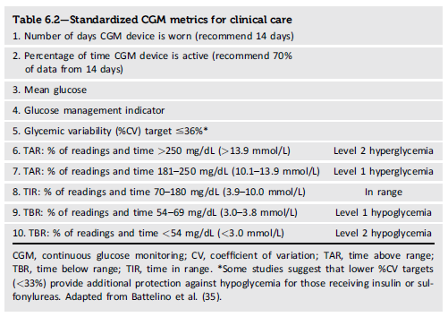
Standardized CGM Metrics
Glycemic targets

Slide 45
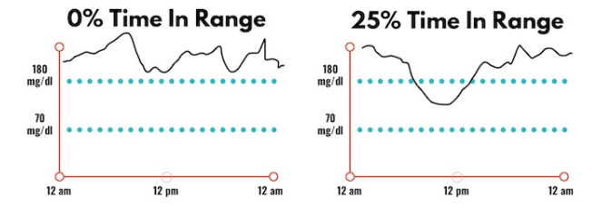
Time in Range

Slide 46
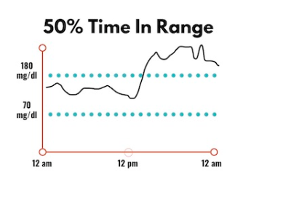
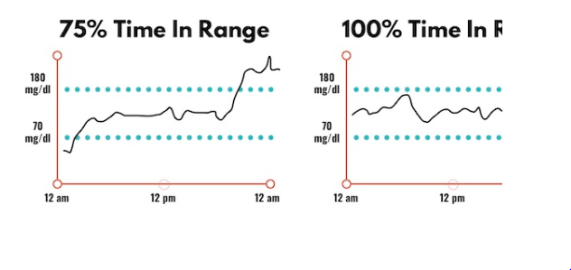
Time in Range

Slide 47
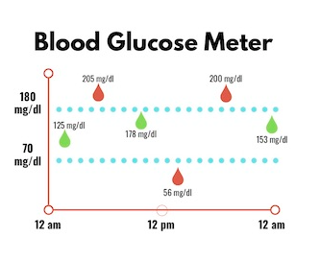
Time in Range

Slide 48
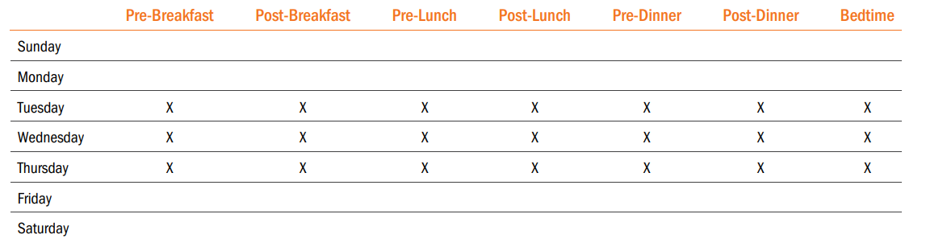

Slide 49
Glucose Assessment by Continuous Glucose Monitoring
Glycemic targets
6.4 Time in range is associated with the risk of microvascular complications and can be used for assessment of glycemic control. Additionally, time below range and time above range are useful parameters for the evaluation of the treatment plan (Table 6.2). C

Slide 50
Glycemic Goals
Glycemic targets
6.5a An A1C goal for many nonpregnant adults of <7% (53 mmol/mol) without significant hypoglycemia is appropriate. A

Slide 51
Glycemic Goals
Glycemic targets
6.5b If using ambulatory glucose profile/glucose management indicator to assess glycemia, a parallel goal for many nonpregnant adults is time in range of >70% with time below range <4% and time <54 mg/dL <1%. For those with frailty or at high risk of hypoglycemia, a target of >50% time in range with <1% time below range is recommended. (See Fig. 6.1 and Table 6.2.). B

Slide 52
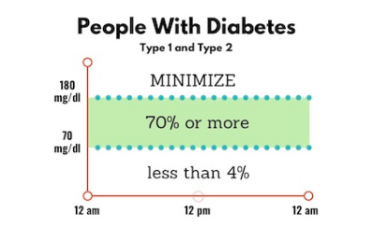
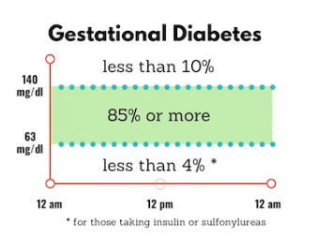
Time in Range

Slide 53
Glycemic Goals
Glycemic targets
6.6 On the basis of health care professional judgment and patient preference, achievement of lower A1C levels than the goal of 7% may be acceptable and even beneficial if it can be achieved safely without significant hypoglycemia or other adverse effects of treatment. B

Slide 54
Glycemic Goals (continued)
Glycemic targets
6.7 Less stringent A1C goals (such as <8% [64 mmol/mol]) may be appropriate for patients with limited life expectancy or where the harms of treatment are greater than the benefits. Health care professionals should consider deintensification of therapy if appropriate to reduce the risk of hypoglycemia in patients with inappropriate stringent A1C targets. B
6.8 Reassess glycemic targets based on the individualized criteria in Fig. 6.2. E
6.9 Reassess Setting a glycemic goal during consultations is likely to improve patient outcomes. E

Slide 55
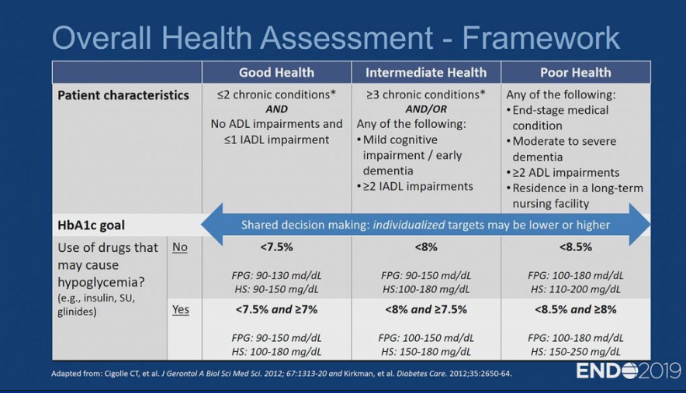

Slide 56
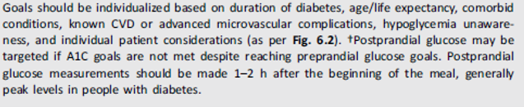
Summary of glycemic recommendations for many nonpregnant adults with diabetes
A1c | <7%
Peripheral capillary plasma glucose | 80-130 mg/dL
Peak postprandial capillary plasma glucose | <180 mg/dL

Slide 57
ASSESSMENT OF COMORBIDITIES
Autoimmune Diseases
Bone Health
Cancer
Cognitive Impairment/Dementia
Dental care
Disability
Hepatitis C
Low Testosterone in Men and Erectile Dysfunction
Female Sexual Dysfunction
Metabolic Dysfunction–Associated Steatotic Liver Disease and Metabolic Dysfunction–Associated Steatohepatitis

Slide 59
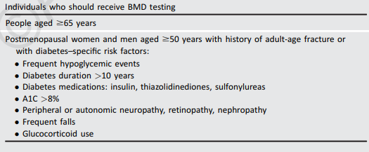
Bone Health

Slide 60
Bone Health
Fracture risk should be assessed in older adults with diabetes as a part of routine care in diabetes clinical practice, according to risk factors and comorbidities. A

Slide 61
Bone Health
Monitor bone mineral density using dual-energy X-ray absorptiometry of high-risk older adults with diabetes (aged >65 years) and younger individuals with diabetes and multiple risk factors every 2–3 years.

Slide 62
Bone Health
To reduce the risk of falls and fractures, glycemic management goals should be individualized for people with diabetes at a higher risk of fracture. Prioritize use of glucose-lowering medications that are associated with low risk for hypoglycemia to avoid falls.

Slide 63
Autoimmune Diseases
Comprehensive Medical Evaluation and Assessment of Comorbidities
People with type 1 diabetes should be screened for autoimmune thyroid disease soon after diagnosis and periodically thereafter.
Adults with type 1 diabetes should be screened for celiac disease in the presence of gastrointestinal symptoms, signs, laboratory manifestations, or clinical suspicion suggestive of celiac disease.

Slide 64
Cognitive Impairment/Dementia
Comprehensive Medical Evaluation and Assessment of Comorbidities
In the presence of cognitive impairment, diabetes treatment plans should be simplified as much as possible and tailored to minimize the risk of hypoglycemia.

Slide 65
Nonalcoholic Fatty Liver Disease
Comprehensive Medical Evaluation and Assessment of Comorbidities
People with type 2 diabetes or prediabetes with cardiometabolic risk factors, who have either elevated liver enzymes (ALT) or fatty liver on imaging or ultrasound, should be evaluated for presence of nonalcoholic steatohepatitis and liver fibrosis.

