Slide 1


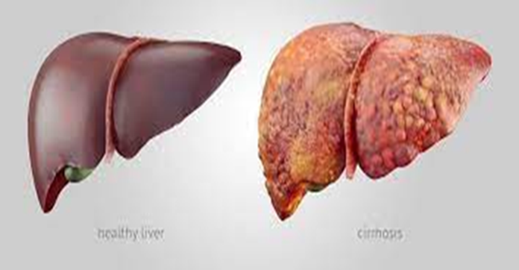



Slide 2
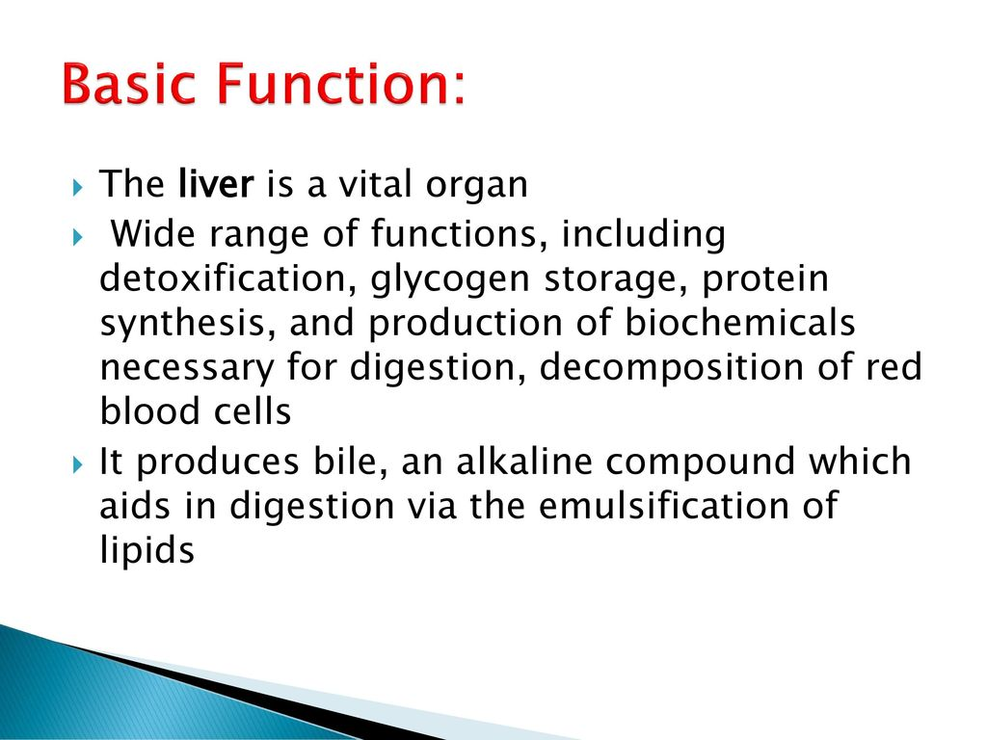

Slide 3
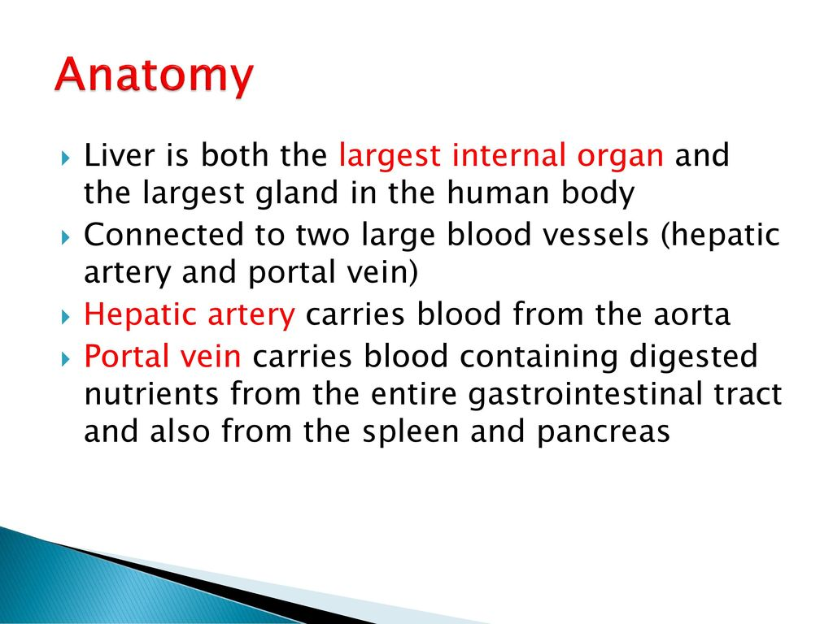

Slide 4
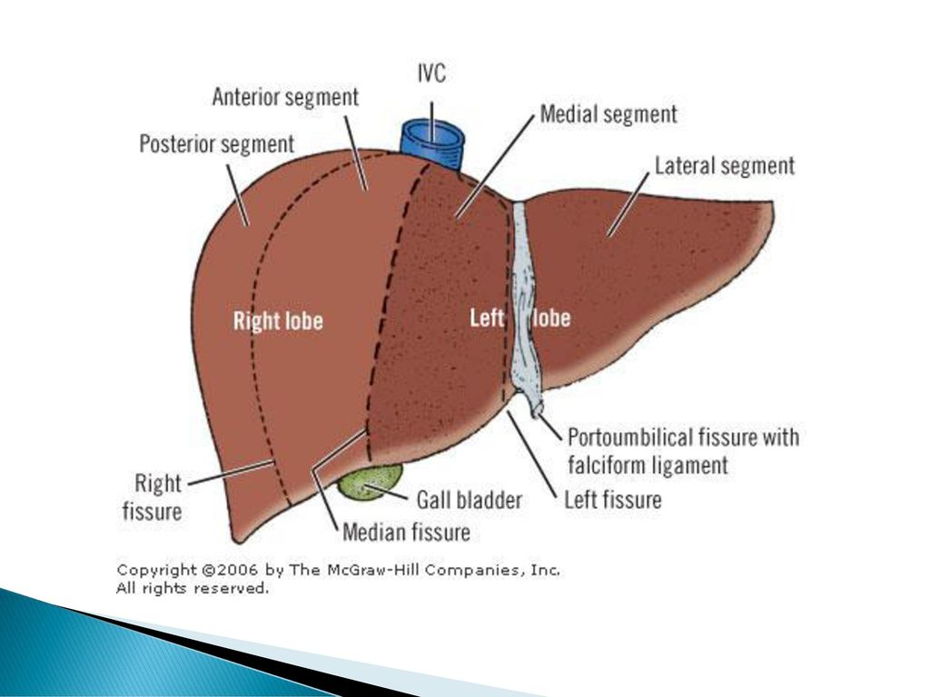

Slide 5
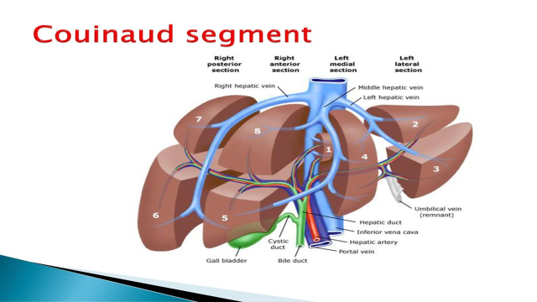

Slide 6
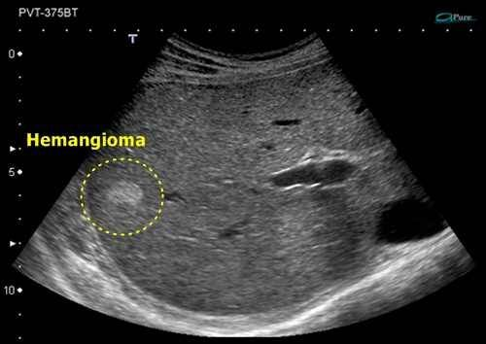
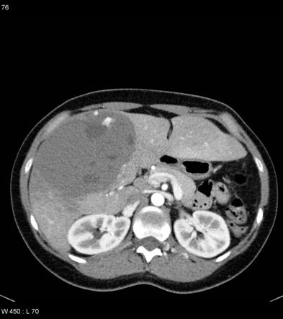
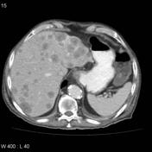
Liver mass

Slide 7
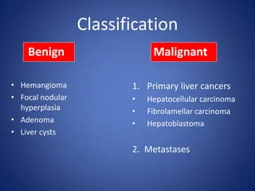

Slide 8
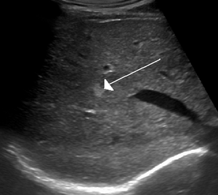
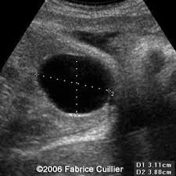
The more common benign tumors of the liver include:
Hemangioma
Hepatic adenoma
Focal nodular hyperplasia
Cysts
They may need to be removed surgically if they cause pain or bleeding.

Slide 9
Hepatic hemangioma
Is the most common benign liver lesion(7%).
can be diagnosed at any age; however, the majority of lesions (up to 80 percent) are diagnosed in patients who are between the ages of 30 and 50 years.
occur more frequently in females with a ratio of approximately 3:1
is most often solitary
most are asymptomatic and have an excellent prognosis.

Slide 10
Focal nodular hyperplasia –(FNH)
is a benign liver lesion that is composed of a proliferation of hyperplastic hepatocytes surrounding a central stellate scar.
Typically, FNH is a solitary lesion that is more commonly seen in women.
In a large observational series including patients referred for ultrasound or contrast-enhanced computed tomography (CT), the prevalence of FNH was 0.2 percent and 1.6 percent, respectively.

Slide 11
Hepatocellular adenoma
is an uncommon solid, benign liver lesion that develops in an otherwise normal-appearing liver.
Typically, is solitary and are found in young females in association with use of estrogen-containing medications.
In addition, patients with glycogen storage disease or metabolic syndrome are at higher risk for developing.

Slide 12
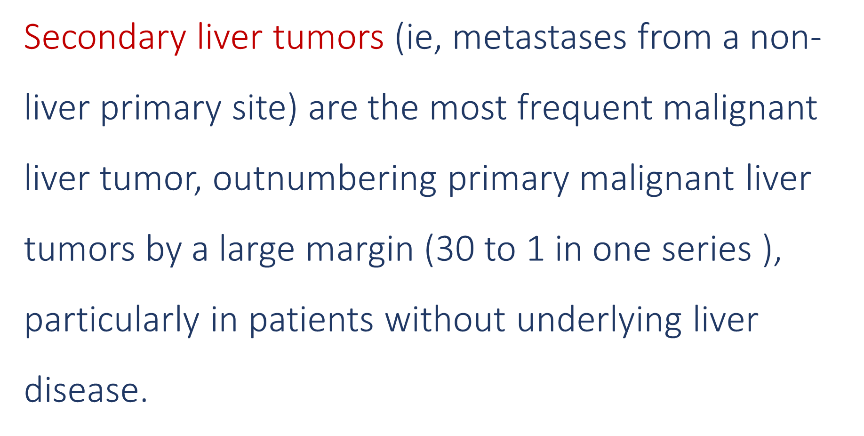

Slide 13
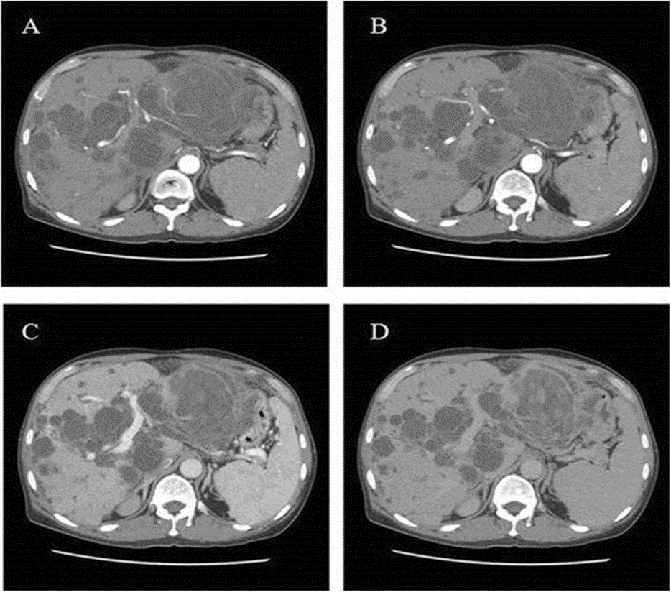
Malignant tumor of Liver
Metastasis
HCC(Hepatocellular Cancer)
Hemangio sarcoma
Hepatoblastoma

Slide 14
HCC is a primary malignancy of the hepatocyte generally leading to death within 6-20 months.
HCC frequently arises in the setting of cirrhosis, appearing 20-30 years following the initial insult to the liver.
However, 25% of patients have no cirrhosis.

Slide 15
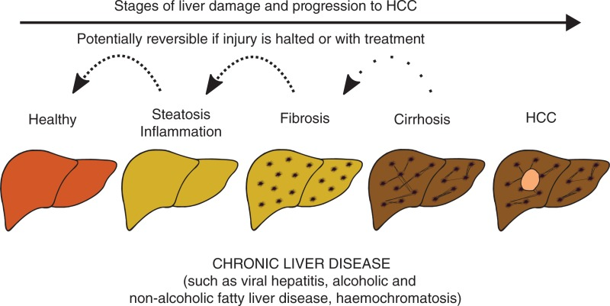

Slide 16
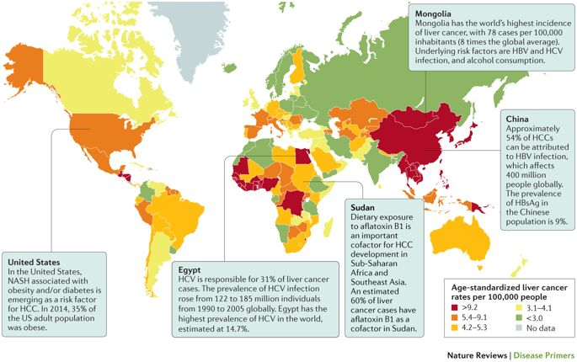

Slide 17
Liver cancer causing substances
vinyl chloride
Arsenic
Smoking, especially if some body abuse alcohol
Aflatoxins
Androgen
Estrogen
Thorotrast.

Slide 18
signs and symptoms
Most people don't have signs and symptoms in the early stages!
weight loss
Loss of appetite
Upper abdominal pain
Nausea and vomiting
General weakness and fatigue
Abdominal swelling
Yellow discoloration of your skin and the whites of your eyes (jaundice)
White, chalky stools

Slide 19
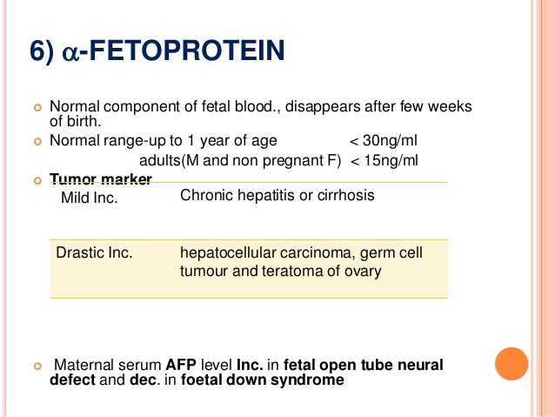
Diagnosing liver cancer
Blood tests.
Imaging tests.
Tissue
………………..
Staging

Slide 20
Treatment
Surgery , In certain situations.
Liver transplant .
Freezing cancer cells. [Cryoablation ].
Heating cancer cells.
Injecting alcohol into the tumor.
Injecting chemotherapy drugs into the liver.[Chemoembolization ]
Radiation therapy.
Targeted drug therapy. [sorafenib (Nexavar)]

Slide 21


